Slide 1
Chapter 17 - C++ Classes: Part II
Outline
17.2 const (Constant) Objects and const Member Functions
17.3 Composition: Objects as Members of Classes
17.4 friend Functions and friend Classes
17.6 Dynamic Memory Allocation with Operators new and delete
17.8 Data Abstraction and Information Hiding
17.8.1 Example: Array Abstract Data Type
17.8.2 Example: String Abstract Data Type
17.8.3 Example: Queue Abstract Data Type
17.9 Container Classes and Iterators

Slide 2
Objectives
In this chapter, you will learn:
  To be able to create and destroy objects dynamically.
  To be able to specify const (constant) objects and const member functions.
  To understand the purpose of friend functions and friend classes.
  To understand the concept of a container class.

Slide 3
17.2 const (Constant) Objects and const Member Functions
Principle of least privilege
  Only give objects permissions they need, no more
Keyword const
  Specify that an object is not modifiable
  Any attempt to modify the object is a syntax error
  For example:
const time noon( 12, 0, 0 );
  Defines a const object noon of class time and initializes it to 12 noon

Slide 4
17.2 const (Constant) Objects and const Member Functions (II)
const objects require const functions
  Functions declared const cannot modify the object
  const specified in function prototype and definition
  Prototype: ReturnType FunctionName(param1,param2…) const;
  Definition: ReturnType FunctionName(param1,param2…) const { …};
  Example:
  int A::getValue() const
  {return privateDataMember};
  Returns the value of a data member, and is appropriately declared const
Constructors / Destructors cannot be const
  They need to initialize variables (therefore modifying them)

Slide 5
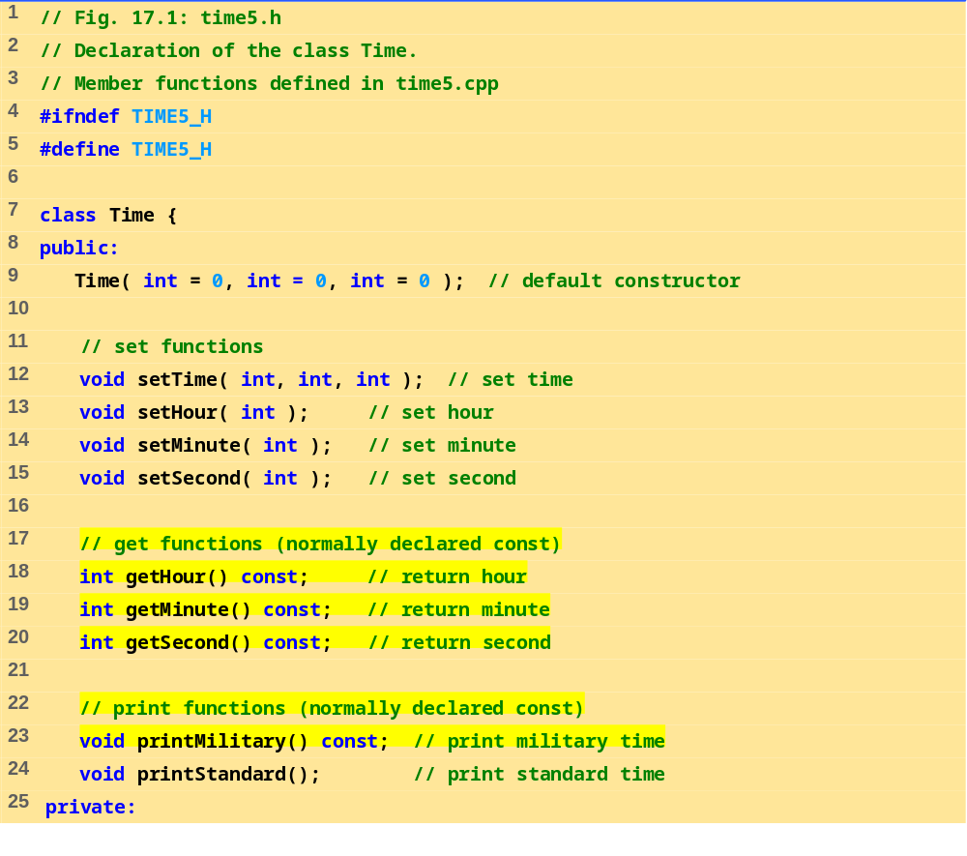
times.h (Part 1 of 2)

Slide 6
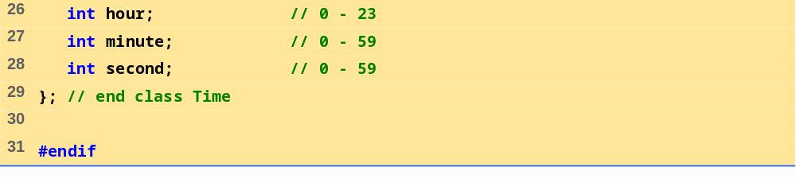
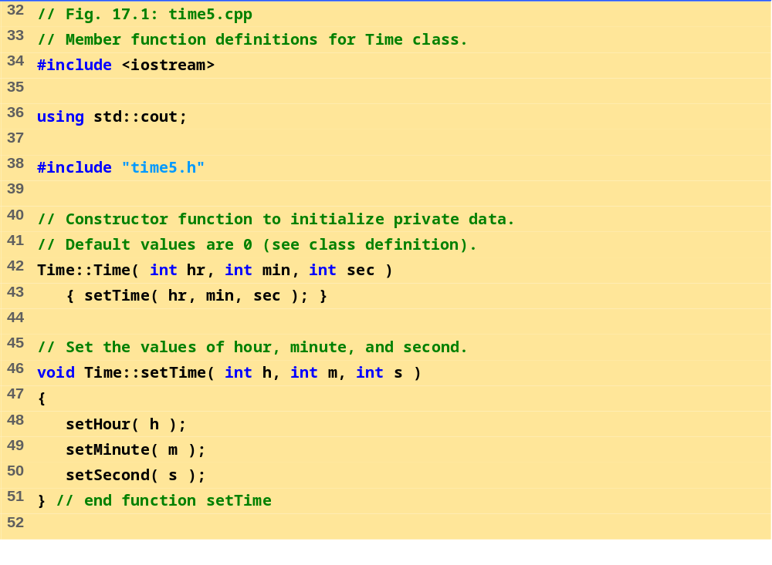
time.h (Part 2 of 2)
time5.h (Part 1 of 3)

Slide 7
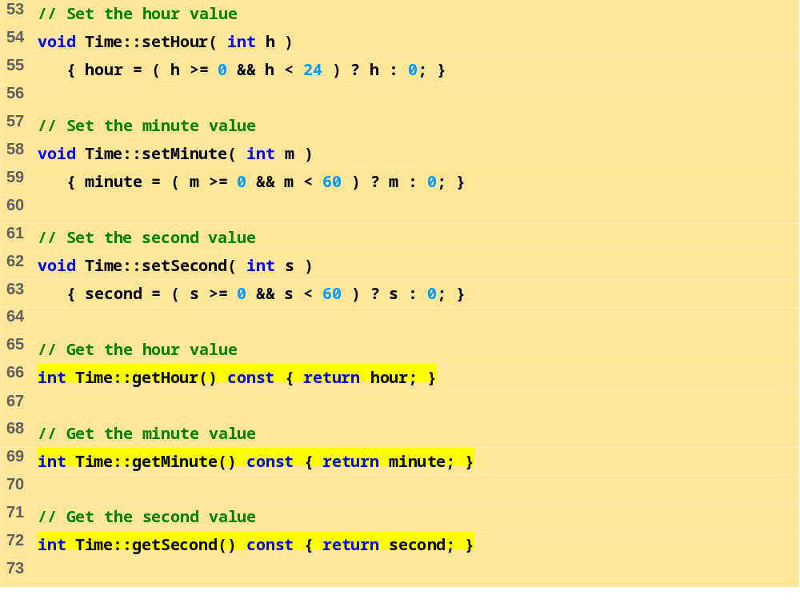
time5.h (Part 2 of 3)

Slide 8
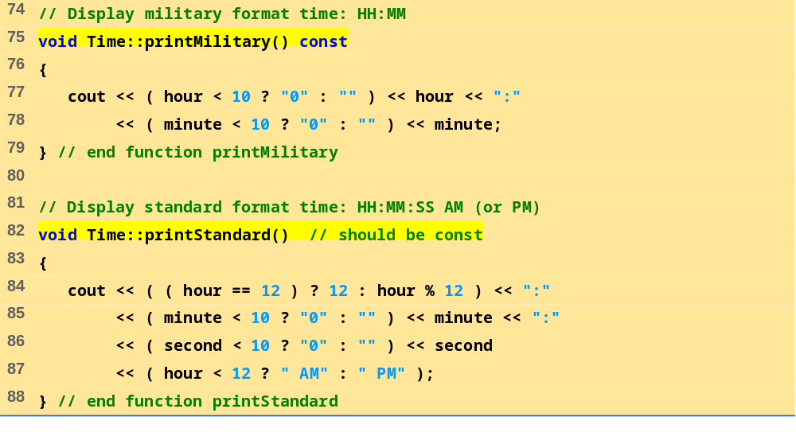
time5.h (Part 3 of 3)

Slide 9
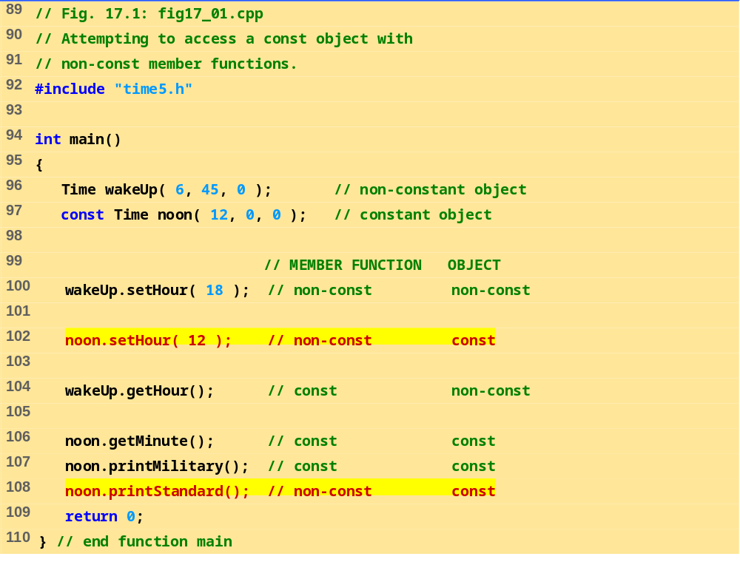
fig17_01.cpp

Slide 10
Compiling...
Fig17_01.cpp
d:fig17_01.cpp(14) : error C2662: 'setHour' : cannot convert 'this' pointer from 'const class Time' to 'class Time &'
Conversion loses qualifiers
d:\fig17_01.cpp(20) : error C2662: 'printStandard' : cannot convert 'this' pointer from 'const class Time' to 'class Time &'
Conversion loses qualifiers
Time5.cpp
Error executing cl.exe.
test.exe - 2 error(s), 0 warning(s)
Program Output

Slide 11
17.2 const (Constant) Objects and const Member Functions (III)
Member initializer syntax
  Data member increment in class Increment.
  Constructor for Increment is modified as follows:
Increment::Increment( int c, int i )
: increment( i )
{ count = c; }
  ": increment( i )" initializes increment to the value of i.
  Any data member can be initialized using member initializer syntax
  consts and references must be initialized this way
Multiple member initializers
  Use comma-separated list after the colon

Slide 12
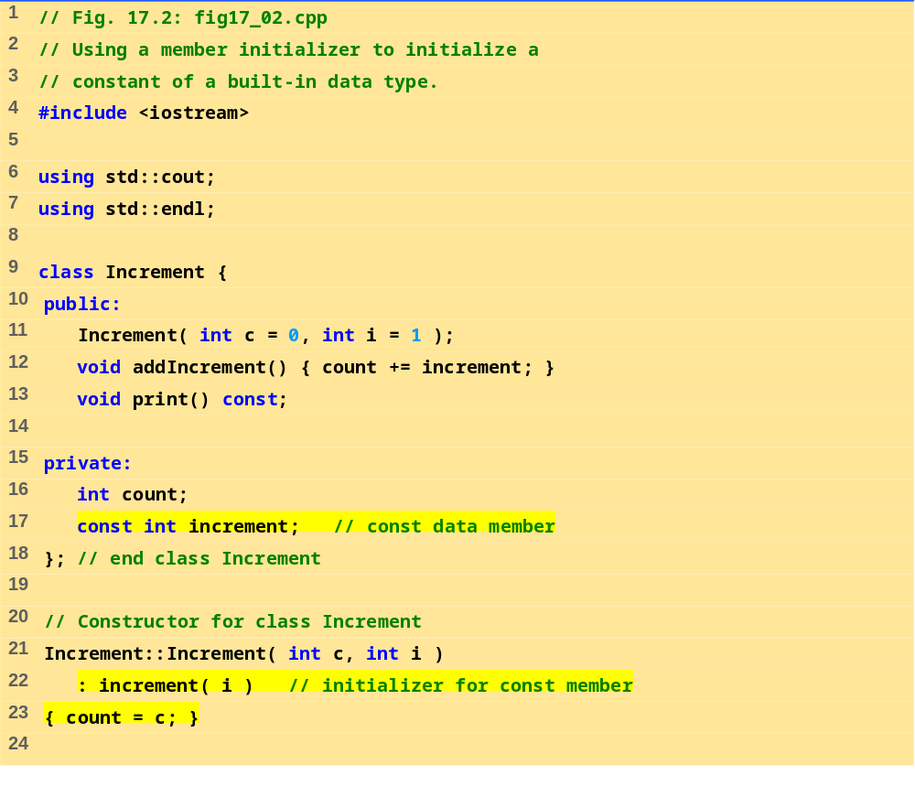
fig17_02.cpp (Part 1 of 2)

Slide 13
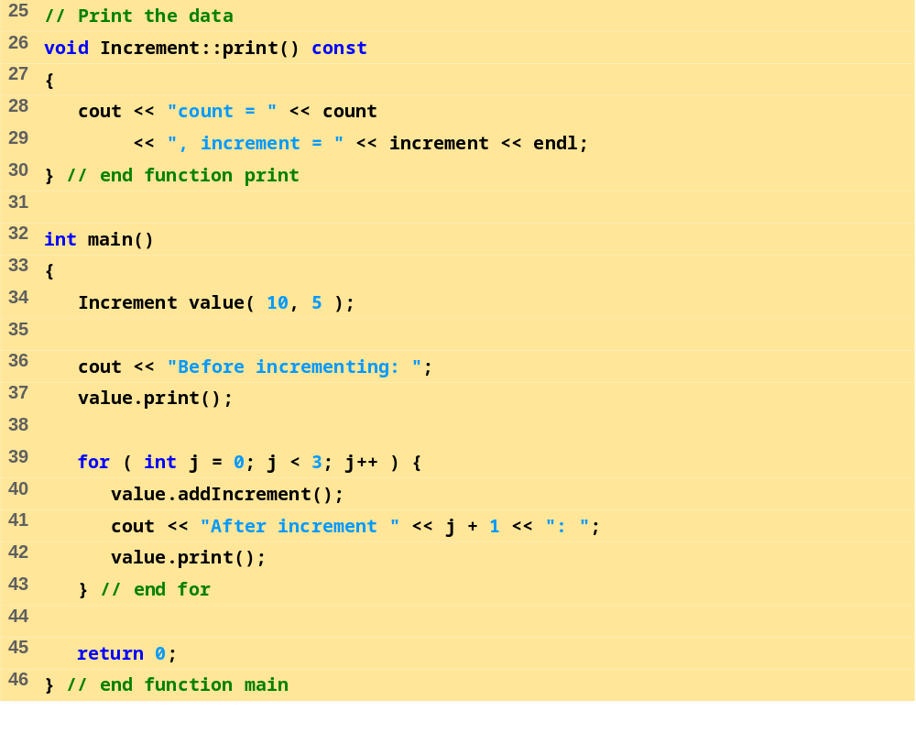
fig17_02.cpp (Part 2 of 2)
Program Output
Before incrementing: count = 10, increment = 5
After increment 1: count = 15, increment = 5
After increment 2: count = 20, increment = 5
After increment 3: count = 25, increment = 5

Slide 14
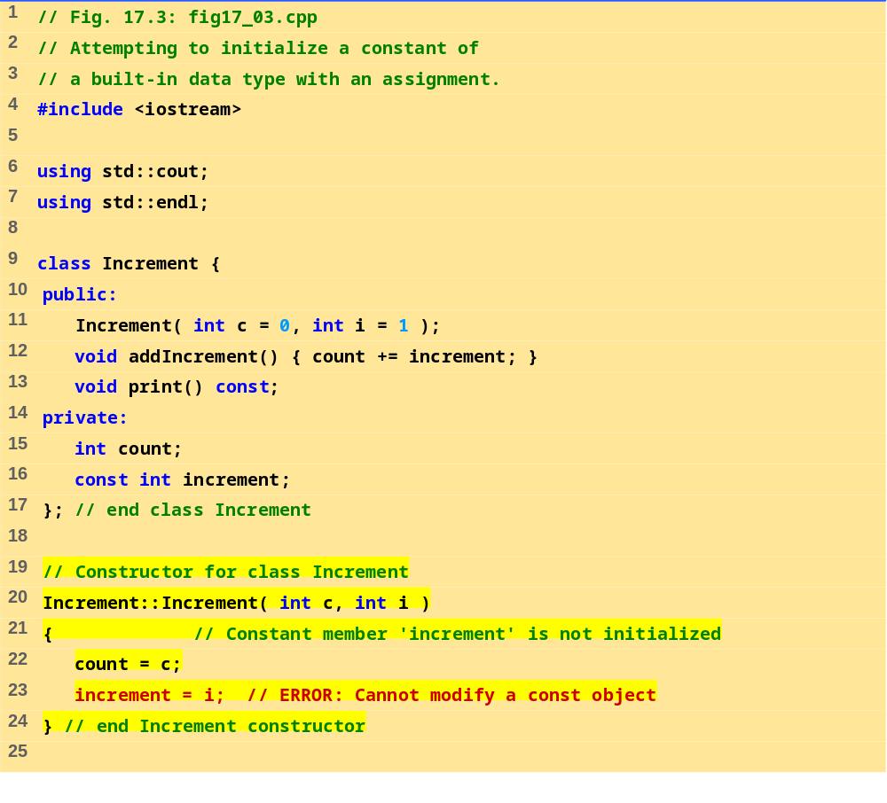
fig17_03.cpp (Part 1 of 2)

Slide 15

fig17_03.cpp (Part 1 of 2)

Slide 16
Compiling...
Fig17_03.cpp
D:\Fig17_03.cpp(21) : error C2758: 'increment' : must be initialized in constructor base/member initializer list
D:\Fig17_03.cpp(16) : see declaration of 'increment'
D:\Fig17_03.cpp(23) : error C2166: l-value specifies const object
Error executing cl.exe.
test.exe - 2 error(s), 0 warning(s)
Program Output

Slide 17
17.3 Composition: Objects as Members of Classes
Composition
  Class has objects of other classes as members
Construction of objects
  Member objects constructed in order declared
    Not in order of constructor’s member initializer list
  Constructed before their enclosing class objects (host objects)
  Constructors called inside out
  Destructors called outside in

Slide 18
17.3 Composition: Objects as Members of Classes (II)
Example:
Employee::Employee( char *fname, char *lname,
int bmonth, int bday, int byear,
int hmonth, int hday, int hyear )
: birthDate( bmonth, bday, byear ),
hireDate( hmonth, hday, hyear )
  Insert objects from Date class (birthDate and hireDate) into Employee class
  birthDate and hireDate have member initializers - they are probably consts in the Employee class

Slide 19
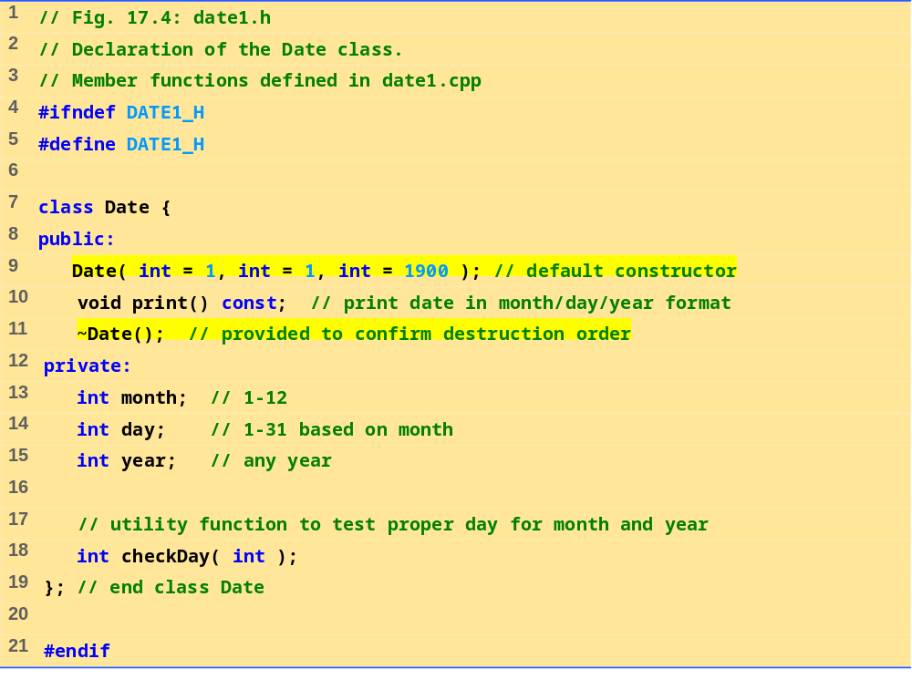
date1.h

Slide 20
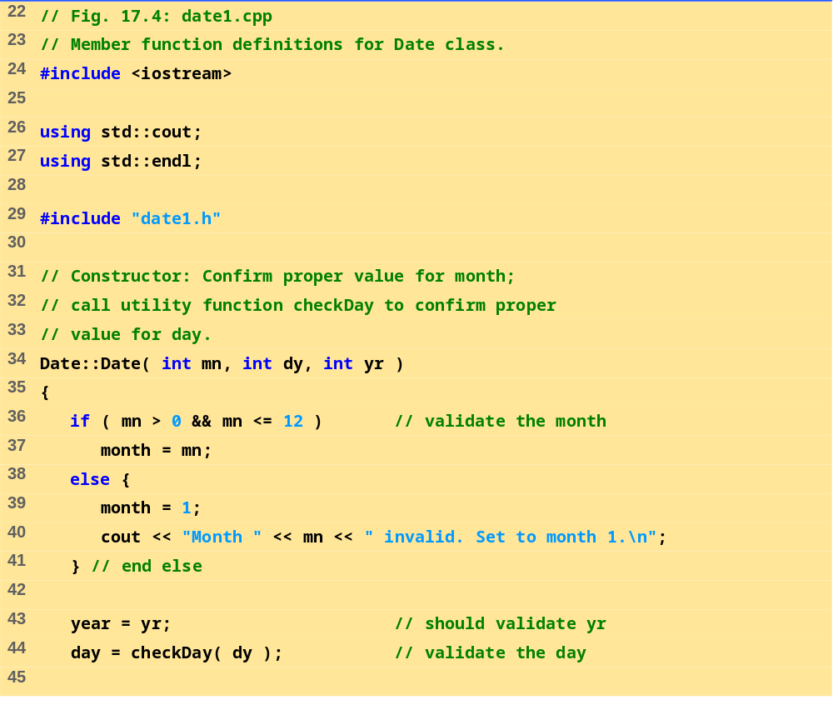
date1.cpp (Part 1 of 3)

Slide 21
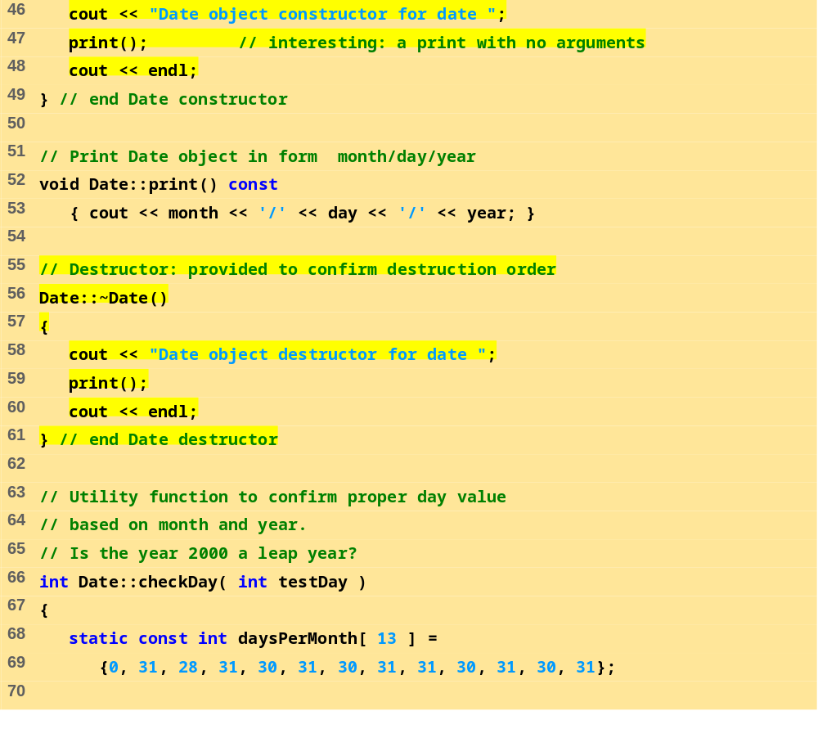
date1.cpp (Part 2 of 3)

Slide 22
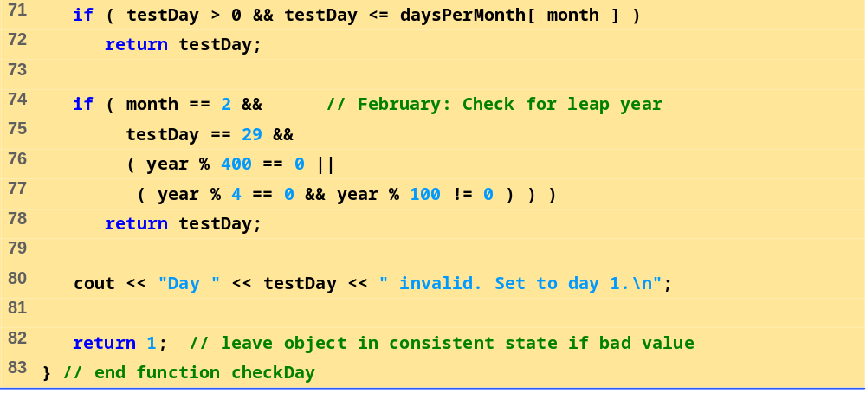
date1.cpp (Part 3 of 3)

Slide 23
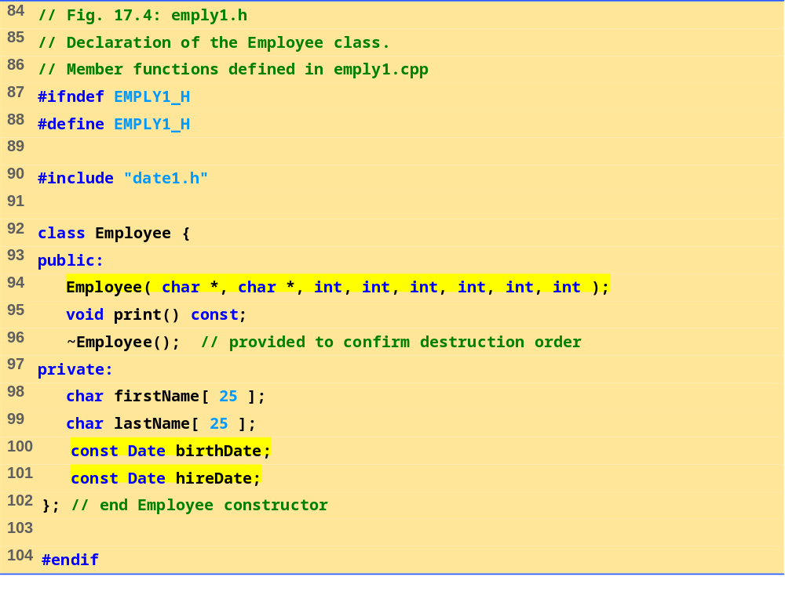
emply1.h

Slide 24
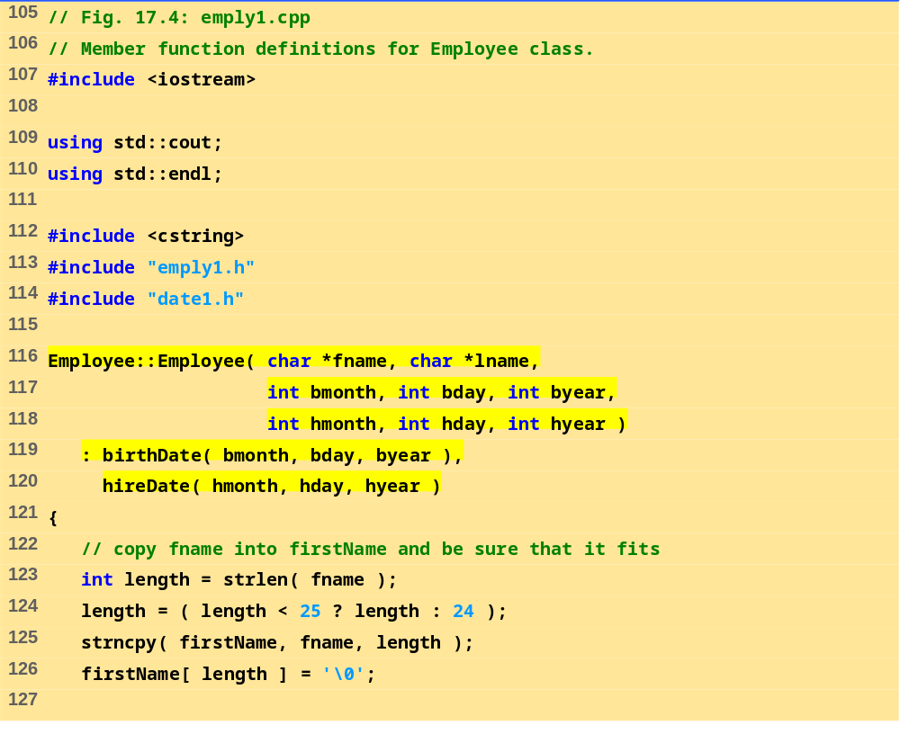
emply1.cpp (Part 1 of 2)

Slide 25
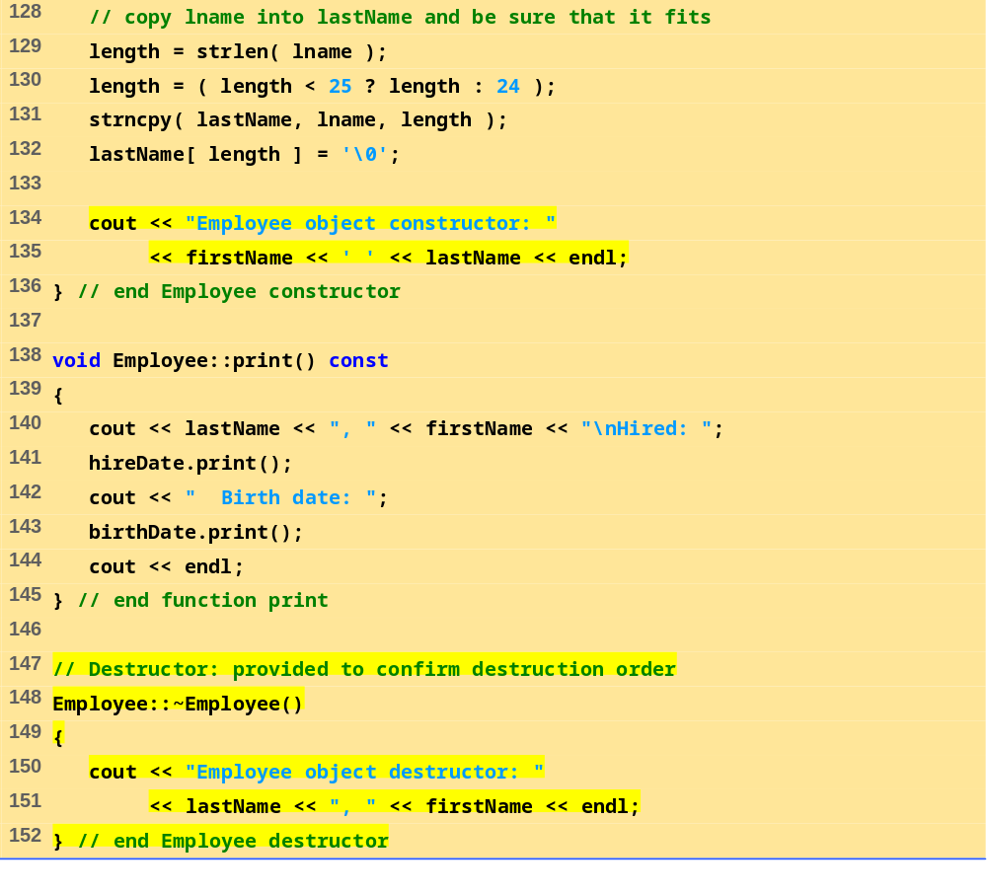
emply1.cpp (Part 2 of 2)

Slide 26
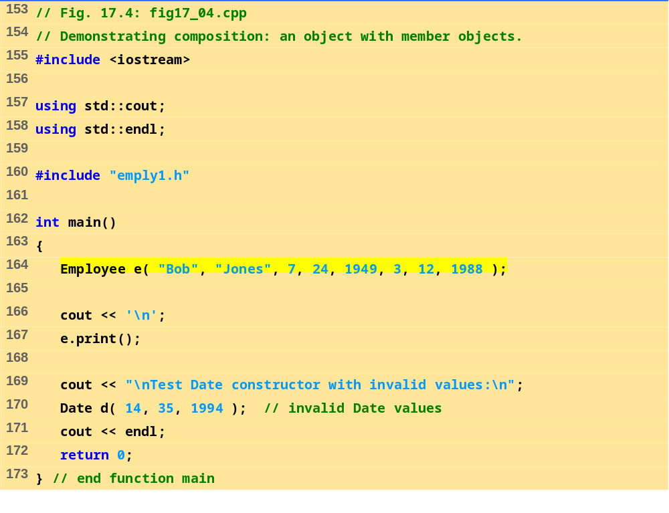
fig17_04.cpp

Slide 27
Date object constructor for date 7/24/1949
Date object constructor for date 3/12/1988
Employee object constructor: Bob Jones
Jones, Bob
Hired: 3/12/1988 Birth date: 7/24/1949
Test Date constructor with invalid values:
Month 14 invalid. Set to month 1.
Day 35 invalid. Set to day 1.
Date object constructor for date 1/1/1994
Date object destructor for date 1/1/1994
Employee object destructor: Jones, Bob
Date object destructor for date 3/12/1988
Date object destructor for date 7/24/1949
Program Output

Slide 28
17.4 friend Functions and friend Classes
friend function and friend classes
  Can access private and protected (more later) members of another class
  friend functions are not member functions of class
    Defined outside of class scope
Properties
  Friendship is granted, not taken
  NOT symmetric (if B a friend of A, A not necessarily a friend of B)
  NOT transitive (if A a friend of B, B a friend of C, A not necessarily a friend of C)

Slide 29
17.4 friend Functions and friend Classes
(II)
friend declarations
  friend function
    Keyword friend before function prototype in class that is giving friendship.
    friend int myFunction( int x );
    Appears in the class granting friendship
  friend class
    Type friend class Classname in class granting friendship
    If ClassOne granting friendship to ClassTwo,
  friend class ClassTwo;
  appears in ClassOne's definition

Slide 30
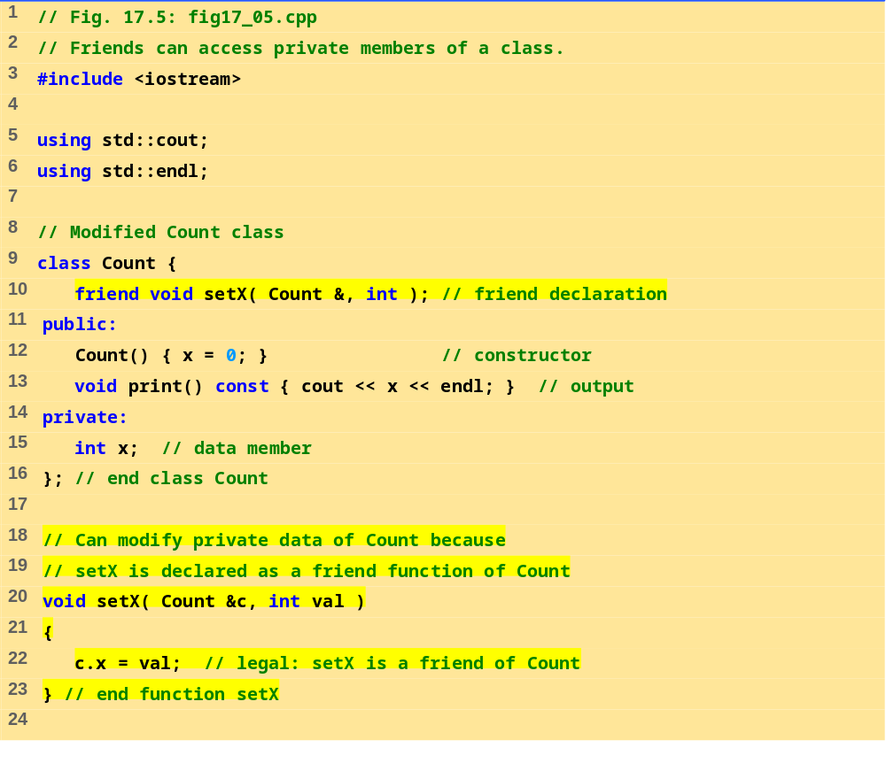
fig17_05.cpp (Part 1 of 2)

Slide 31
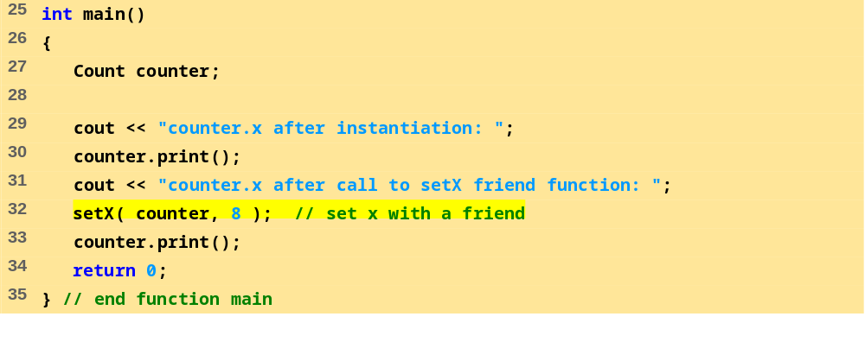
fig17_05.cpp (Part 1 of 2)
Program Output
counter.x after instantiation: 0
counter.x after call to setX friend function: 8

Slide 32
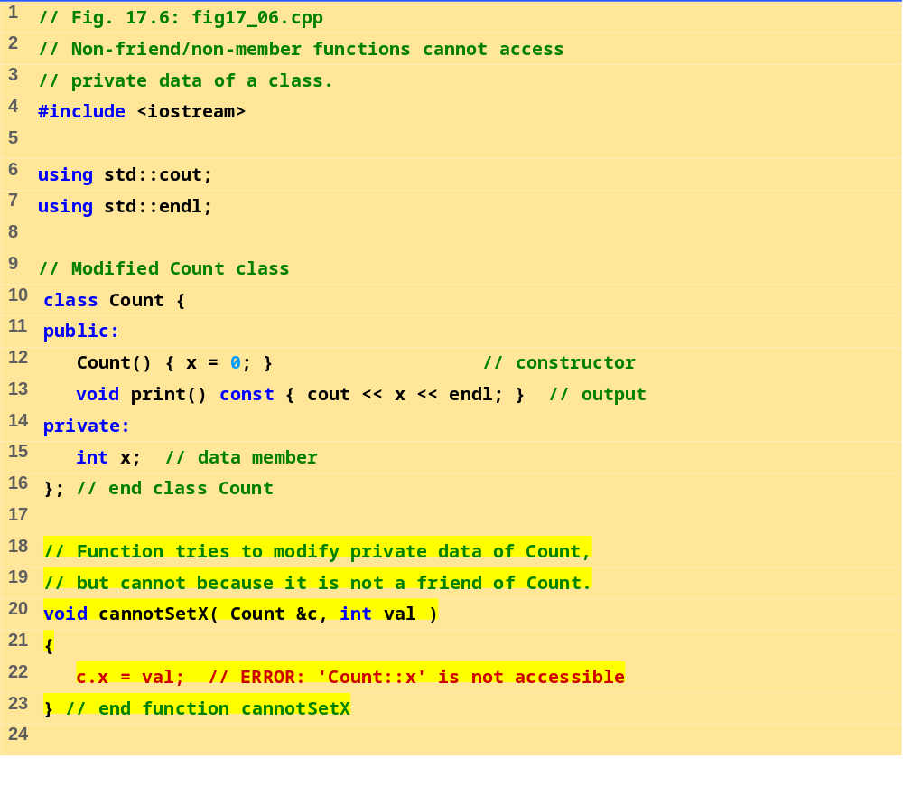
fig17_06.cpp (Part 1 of 2)

Slide 33
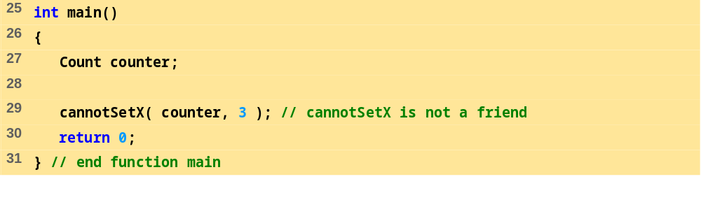
fig17_06.cpp (Part 2 of 2)
Program Output
Compiling...
Fig17_06.cpp
D:\Fig17_06.cpp(22) :
error C2248: 'x' : cannot access private member declared in
class 'Count'
D:\Fig17_06.cpp(15) : see declaration of 'x'
Error executing cl.exe.
test.exe - 1 error(s), 0 warning(s)

Slide 34
17.6 Dynamic Memory Allocation with Operators new and delete
new and delete
  Better dynamic memory allocation than C’s malloc and free
  new - automatically creates object of proper size, calls constructor, returns pointer of the correct type
  delete - destroys object and frees space
Example:
  TypeName *typeNamePtr;
    Creates pointer to a TypeName object
  typeNamePtr = new TypeName;
    new creates TypeName object, returns pointer (which typeNamePtr is set equal to)
  delete typeNamePtr;
    Calls destructor for TypeName object and frees memory

Slide 35
17.6 Dynamic Memory Allocation with Operators new and delete (II)
Initializing objects
  double *thingPtr = new double( 3.14159 );
  Initializes object of type double to 3.14159
  int *arrayPtr = new int[ 10 ];
  Create ten element int array, assign to arrayPtr.
  Use
    delete [] arrayPtr;
    to delete arrays

Slide 36
17.8 Data Abstraction and Information Hiding
Information hiding
  Classes hide implementation details from clients
  Example: stack data structure
    Data elements like a pile of dishes - added (pushed) and removed (popped) from top
    Last-in, first-out (LIFO) data structure
  Client does not care how stack is implemented, only wants LIFO data structure

Slide 37
17.8 Data Abstraction and Information Hiding (II)
Abstract data types (ADTs)
  Model real world objects
    int, float are models for a number
    Imperfect - finite size, precision, etc.
C++ an extensible language
  Base cannot be changed, but new data types can be created

Slide 38
17.8.1 Example: Array Abstract Data Type
Array
  Essentially a pointer and memory locations
Programmer can make an ADT array
  New capabilities
    Subscript range checking, array assignment and comparison, dynamic arrays, arrays that know their sizes...
New classes
  Proprietary to an individual, to small groups or to companies, or placed in standard class libraries

Slide 39
17.8.2 Example: String Abstract Data Type
C++ intentionally sparse
  Reduce performance burdens
  Use language to create what you need, i.e. a string class
string not a built-in data type
  Instead, C++ enables you to create your own string class

Slide 40
17.8.3 Example: Queue Abstract Data Type
Queue - a waiting line
  Used by computer systems internally
  We need programs that simulate queues
Queue has well-understood behavior
  Enqueue - put things in a queue one at a time
  Dequeue - get those things back one at a time on demand
  Implementation hidden from clients
Queue ADT - stable internal data structure
  Clients may not manipulate data structure directly
  Only queue member functions can access internal data

Slide 41
17.9 Container Classes and Iterators
Container classes (collection classes)
  Classes designed to hold collections of objects
  Services such as insertion, deletion, searching, sorting, or testing an item
  Examples:
  Arrays, stacks, queues, trees and linked lists
Iterator objects (iterators)
  Object that returns the next item of a collection (or some action)
  Can have several iterators per container
    Book with multiple bookmarks
  Each iterator maintains its own “position” information

